Slide 1
1
CSE 423: VIRTUALIZATION & CLOUD COMPUTING
UNIT – I, PART - C
OVERVIEW OF DISTRIBUTED COMPUTING
Abhishek Bhattacherjee
Preferred Text Book
Cloud Computing Bible: Barrie Sosinky – 1st Edition, Wiley India Pvt. Ltd.
Cloud Computing: Fundamentals, Industry Approach & Trends by Rishabh Sharma, Wiley
Cloud Computing: Principles & Paradigms by Raj Kumar Buyya, James Broberg, Andrzej Goscinski, Wiley

Slide 2
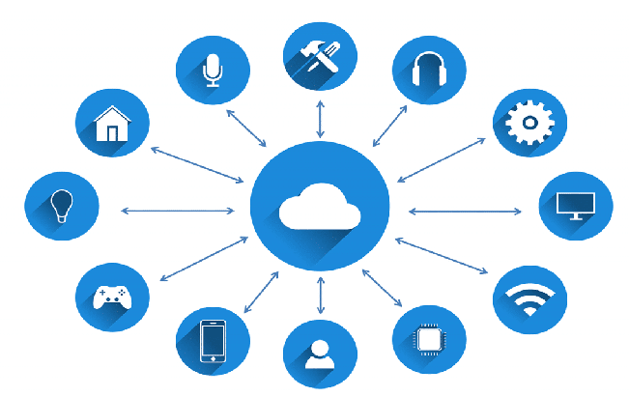
2
PART -II: PARALLEL & DISTRIBUTED COMPUTING
CONTENT
DISTRIBUTED COMPUTING
Parallel and Distributed Systems
Parallel Computing
Parallel Computer Architecture
Distributed Systems
Differences & Similarities

Slide 3
3
PART -II: PARALLEL & DISTRIBUTED COMPUTING
INTRODUCTION
DISTRIBUTED SYSTEMS
It is a collection of independent entities that cooperate to solve a problem that cannot be individually solved.
It’s been in existence since the start of the universe.
For computing systems, a distributed system has been characterized as follows:
A collection of computers that do not share common memory or a common physical clock, that communicate by message passing over a communication network. Each computer has its own memory and runs its own operating system
A collection of independent computers that appear to the users of the system as a single coherent computer.
A term that describes a wide range of computers, from weakly coupled systems such as wide area networks, to strongly coupled systems such as local area networks to very strongly coupled systems such as multiprocessor systems.

Slide 4
4
PART -II: PARALLEL & DISTRIBUTED COMPUTING
INTRODUCTION
FEATURES OF DISTRIBUTED SYSTEMS
No Common Physical Clock
It is am important assumption as it introduces the element of “distribution” in the system and gives rise to the inherent asynchrony amongst the processors.
No Shared Memory
A key feature that requires message passing for communication.
This feature implies the absence of the common physical clock
Geographical Separation:
Geographically the wider apart the processors are, the more representative the system of the distributed system.
It is not necessary for the processors to be on a wide area network .
Autonomy and Heterogeneity: The processors are “loosely coupled”. They have different speeds and each can be running on a different operating system. They are not part of dedicated systems, but cooperate with one another by offering services or solving a problem jointly.

Slide 5
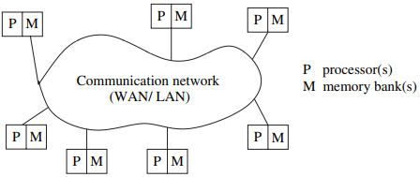
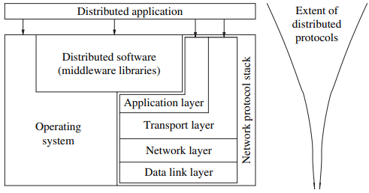
5
PART -II: PARALLEL & DISTRIBUTED COMPUTING
RELATION TO COMPUTER SYSTEM COMPONENT
The distributed system is presented as:
Each computer has a memory processing unit and the computers are connected by a communication network.
It shows the relationship of the software components that run on each of the computers and use the local operating system and network protocol stack for functioning.
The distributed software is also termed as “middleware”
A distributed execution is the execution of the process across the distributed system to collaboratively achieve a common goal.
An execution is also termed as a “computation” or “run”

Slide 6
6
PART -II: PARALLEL & DISTRIBUTED COMPUTING
RELATION TO COMPUTER SYSTEM COMPONENT
The distributed system is presented as:
The distributed system uses the layered architecture to break down the complexity of system design.
The middleware is the distributed software that drives the distributed system. It provides the transparency of heterogeneity at the platform level
It is assumed that the middleware layer does not contain the traditional application layer functions of the network protocol stack such as HTTP, MAIL, FTP and TELNET
Various primitives and calls to functions defined in various libraries of the middleware layer are embedded in the user program code

Slide 7
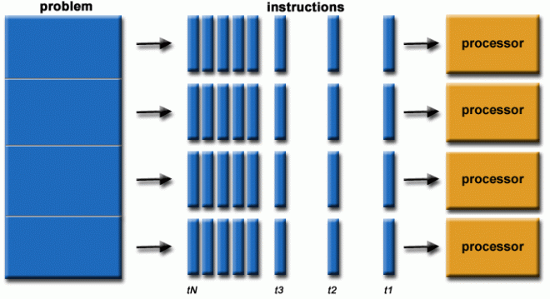
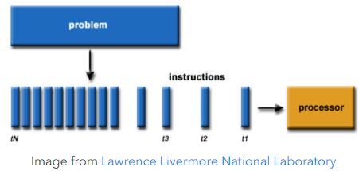
7
PART -II: PARALLEL & DISTRIBUTED COMPUTING
PARALLEL COMPUTING
INTRODUCTION
It is the use of multiple processing elements simultaneously for solving any problem.
Problems are broken down into instructions and are solved concurrently as each resource that has been applied to work is working at the same time.
Advantages (over Serial Computing)
It saves time and money as many resources working together will reduce the time and cut potential costs.
It can be impractical to solve larger problems on Serial Computing.
It can take advantage of non-local resources when the local resources are finite.
Serial Computing ‘wastes’ the potential computing power, thus Parallel Computing makes better work of the hardware.

Slide 8
8
PART -II: PARALLEL & DISTRIBUTED COMPUTING
PARALLEL COMPUTING
TYPES OF PARALLELISM
Bit Level Parallelism
It is the parallel computing form based on the increasing processor’s size.
It reduces the number of instructions that the system must execute in order to perform a task on large-sized data.
Instruction Level Parallelism
A processor can only address less than one instruction for each clock cycle phase.
These instructions can be re-ordered and grouped which are later on executed concurrently without affecting the result of the program.
This is called instruction-level parallelism.
Task Parallelism
It employs the decomposition of a task into subtasks and then allocates each of the subtasks for execution.
The processors perform the execution of sub-tasks concurrently.

Slide 9
Bit-level parallelism
Bit-level parallelism is a form of parallel computing based on increasing processor word size. Increasing the word size reduces the number of instructions the processor must execute in order to perform an operation on variables whose sizes are greater than the length of the word.
For example, a processor with a 32-bit word size can perform 4 independent 1-byte additions simultaneously. If the processor size is 1 byte, it would need to perform 4 operations.

Slide 10
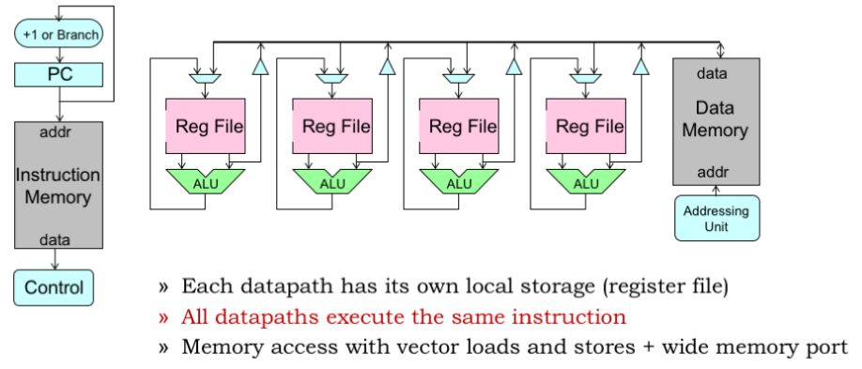
10
PART -II: PARALLEL & DISTRIBUTED COMPUTING
PARALLEL COMPUTING
TYPES OF PARALLELISM
Data Level Parallelism
Instructions from a single stream operate concurrently on several data – Limited by non-regular data manipulation patterns and by memory bandwidth
WHY PARALLEL COMPUTING?
Real-world data needs more dynamic simulation and modeling, and for achieving the same, parallel computing is the key.
Parallel computing provides concurrency and saves time and money.
Complex, large datasets, and their management can be organized only and only using parallel computing’s approach
Ensures the effective utilization of the resources
APPLICATIONS
Databases and Data mining.
Real-time simulation of systems
Advanced graphics, augmented reality, and virtual reality.

Slide 11
11
PART -II: PARALLEL & DISTRIBUTED COMPUTING
PARALLEL COMPUTING
LIMITATIONS OF PARALLEL COMPUTING
It addresses such as communication and synchronization between multiple sub-tasks and processes which is difficult to achieve.
The algorithms must be managed in such a way that they can be handled in a parallel mechanism.
The algorithms or programs must have low coupling and high cohesion. But it’s difficult to create such programs.
More technically skilled and expert programmers can code a parallelism-based program well.

Slide 12
12
PART -II: PARALLEL & DISTRIBUTED COMPUTING
PARALLEL COMPUTING ARCHITECTURE
Parallel Architecture Types:
The parallel computer architecture is classified based on the following:
Multiprocessors
Multi Computers
Models based on Shared Memory Multi Computers:
Uniform Memory Access (UMA)
all the processors share the physical memory uniformly.
All the processors have equal access time to all the memory words.
Each processor may have a private cache memory.
Same rule is followed for peripheral devices.
When all the processors have equal access to all the peripheral devices, the system is called a symmetric multiprocessor.
When only one or a few processors can access the peripheral devices, the system is called an asymmetric multiprocessor.

Slide 13
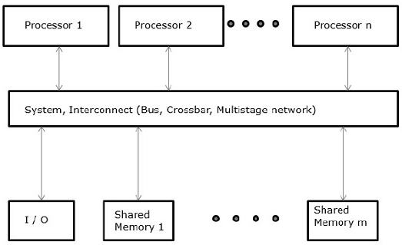
13
PART -II: PARALLEL & DISTRIBUTED COMPUTING
PARALLEL COMPUTING ARCHITECTURE
Parallel Architecture Types:
Uniform Memory Access (UMA)
When all the processors have equal access to all the peripheral devices, the system is called a symmetric multiprocessor.
When only one or a few processors can access the peripheral devices, the system is called an asymmetric multiprocessor.

Slide 14
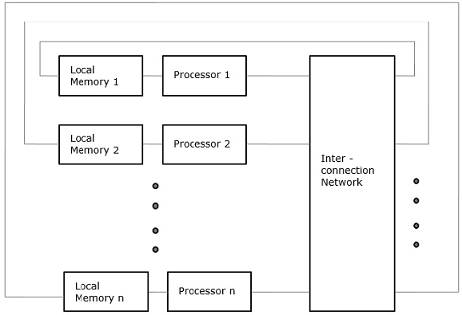
14
PART -II: PARALLEL & DISTRIBUTED COMPUTING
PARALLEL COMPUTING ARCHITECTURE
Parallel Architecture Types:
Non-Uniform Memory Access (NUMA)
In the NUMA multiprocessor model, the access time varies with the location of the memory word.
In this, the shared memory is physically distributed among all the processors, called local memories.
The collection of all local memories forms a global address space that can be accessed by all the processors.

Slide 15
15
PART -II: PARALLEL & DISTRIBUTED COMPUTING
DISTRIBUTED SYSTEM TYPES
Distributed System Types
The nodes in the distributed system can be arranged in the form of client/server or peer-to-peer systems.
Client/Server Model
In this the client request the resources and the server provides the resources.
A server may serve multiple clients at the same time while a client is in contact with only one server
The client and the server communicate with each other via computer networks.
Peer-to-Peer Model
They contain nodes that are equal participants in data sharing.
All the tasks are equally divided between all the nodes.
The nodes interact with each other as required and share the resources.

Slide 16
16
PART -II: PARALLEL & DISTRIBUTED COMPUTING
DISTRIBUTED SYSTEM – ADVANTAGES/DIS. ADV.
Advantages of Distributed System
All the nodes in the distributed system are connected to each other. So nodes can share data with other nodes
More nodes are easily be added to the distributed system i.e. it can scale as required
Failure of one node does not lead to the failure of an entire distributed system. Other nodes can still communicate with each other.
Resources like printers can be shared with multiple nodes rather than been restricted to just one
Dis-Advantages of Distributed System
It is difficult to provide adequate security in distributed systems because the nodes as well the connection need to be secured
Some messages and data can be lost in the network while traveling from one node to another
The database connected to the distributed system is quite complicated and difficult to handle as compared to a single user system
Overloading may occur in the network if all the nodes try to send data at once.

Slide 17
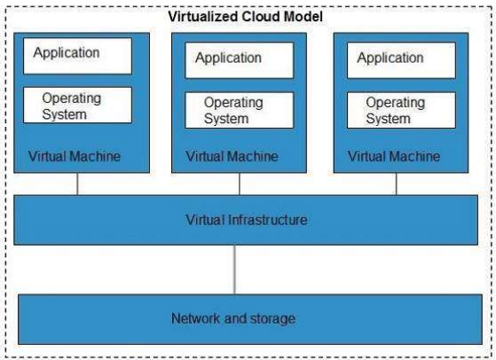
17
PART -II: PARALLEL & DISTRIBUTED COMPUTING
DISTRIBUTED COMPUTING MODELS
The Models are:
Virtualization
Service-oriented Architecture (SOA)
Grid Computing
Utility Computing
Virtualization
It is a technique that allows sharing single physical instance of an application or resource among multiple organization or tenants

Slide 18
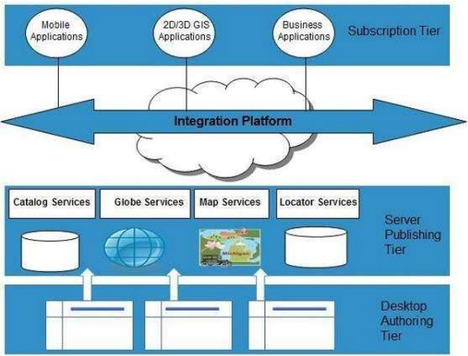
18
PART -II: PARALLEL & DISTRIBUTED COMPUTING
DISTRIBUTED COMPUTING MODELS
Service-Oriented Architecture
It helps to use the application as a service for other applications regardless of the type of vendor, product, or technology
It is possible to exchange the data between applications of different vendors without additional programming or making changes to service.

Slide 19
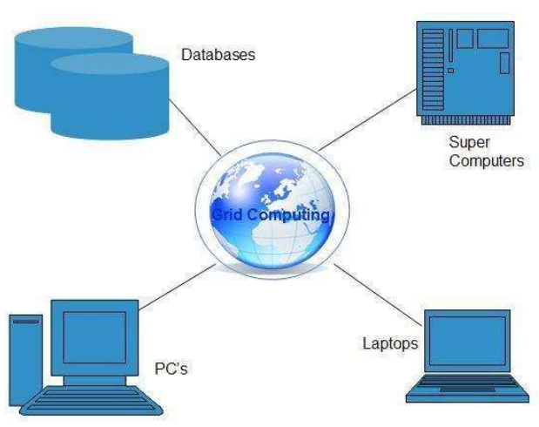
19
PART -II: PARALLEL & DISTRIBUTED COMPUTING
DISTRIBUTED COMPUTING MODELS
Grid Computing
It refers to distributed computing, in which a group of computers from multiple locations are connected with each other to achieve a common objective. These computer resources are heterogeneous and graphically distributed.
It breaks complex tasks into smaller pieces, which are distributed to CPUs that reside within the grid.
Utility Computing
It is based on a pay-per-use model.
It offers computational resources on-demand as a metered service.
Cloud computing, Grid computing and managed IT services are based on the concept of utility computing.

Slide 20
What is utility computing with examples?
Utility computing basically refers to the utility computing technologies and the business models that are offered by a service provider to the IT customers. The client is charged as per their consumption. Examples of these IT services are storage, computing power, and applications.

Slide 21
21
PART -II: PARALLEL & DISTRIBUTED COMPUTING
COMPARISION OF PARALLEL & DISTRIBUTED COMPUTING
Parallel Computing
In parallel computing multiple processors perform multiple tasks assigned to them simultaneously
Memory in a Parallel system can either be shared or distributed.
Parallel Computing Provides concurrency and saves time and money.
Distributed Computing
In this, multiple autonomous computers will be working and it seems to the user as a single system.
In this there is no shared memory and computers communicate with each other through message passing.
In this computing, a single task is divided among different computers.

Slide 22
22
PART -II: PARALLEL & DISTRIBUTED COMPUTING
COMPARISION OF PARALLEL & DISTRIBUTED COMPUTING
Parameter | Parallel Computing | Distributed Computing
Parallel vs. Distributed | Parallel computing is a computation type in which multiple processors execute multiple tasks simultaneously | Distributed computing is a computation type in which multiple computers execute common tasks while communicating with each other using message passing
No. of Computers Required | Parallel computing occurs on one computer. | Distributed computing occurs between multiple computers.
Processing Mechanism | In parallel computing multiple processors perform processing. | In distributed computing, computers rely on message passing.
Synchronization | All processors share a single master clock for synchronization | There is no global clock in distributed computing, it uses synchronization algorithms.
Memory | In Parallel Computing, computers can have shared memory or distributed memory | In Distributed computing, each computer has their own memory
Usage | Parallel computing is used to increase performance and for scientific computing | Distributed computing is used to share resources and to increase scalability.

